Slide 1

Project Proposal Network Performance Evaluation on Linux Operating System
Client: Dr. Raymond Lutui | Mentor: Daniel Vaipulu

Slide 2
Team - Introduction
Nathan
Thomas
Zafar
Kylie
Win
Charmi
Larissa

Slide 3
Executive Summary
Ubuntu, Fedora, Kali Linux Distro
IPv4 and IPv6 in TCP and UDP Protocols
Metrics – throughput, latency, packet loss, jitter
iPerf and D-ITG
Estimated Cost: NZD$125,721.31

Slide 4
Project Scope – Functional Requirements

Slide 5
Project Scope – Non-Functional Requirements

Slide 6
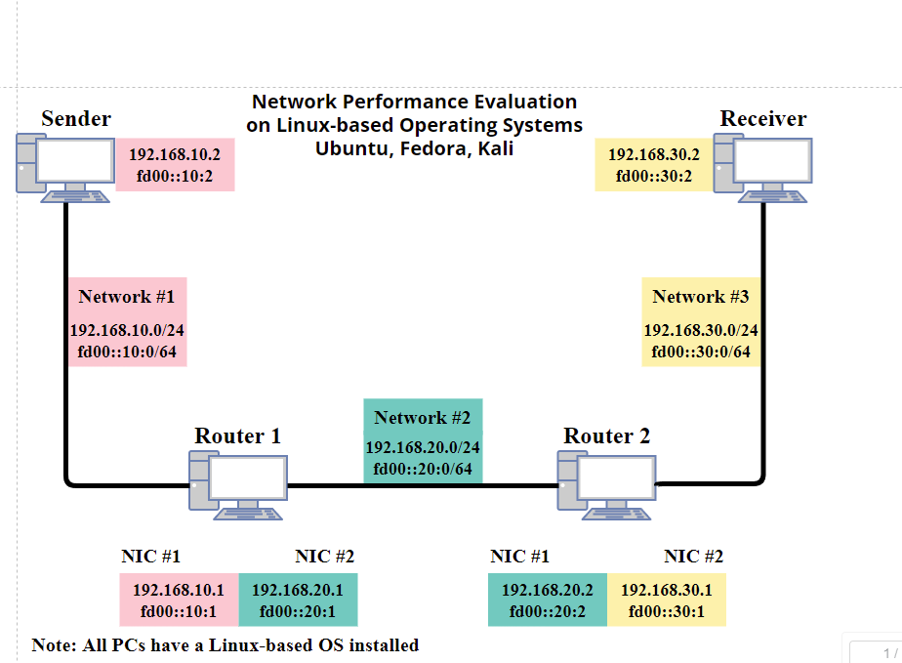
Technical Infrastructure

Slide 7
Feasibility

Slide 8
Upskilling Plans

Slide 9
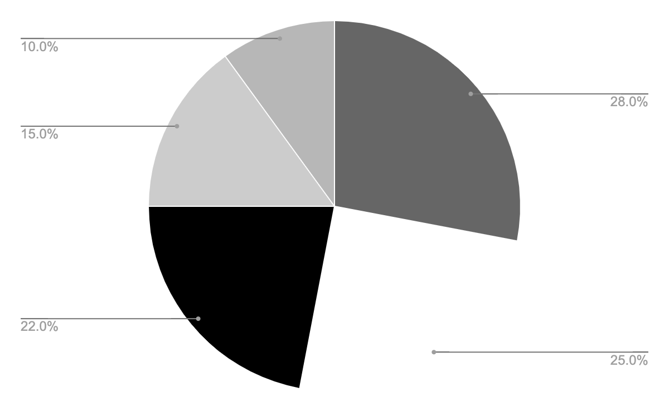
Estimated Cost Breakdown
Labor
Materials
Equipment
Overhead
Other
Follow the link in the graph to modify its data and then paste the new one here. For more info, click here

Slide 10
Project Methodology

Slide 11
Risk Register

Slide 12
Issue Register

Slide 13
Quality Assurance Plan

Slide 14
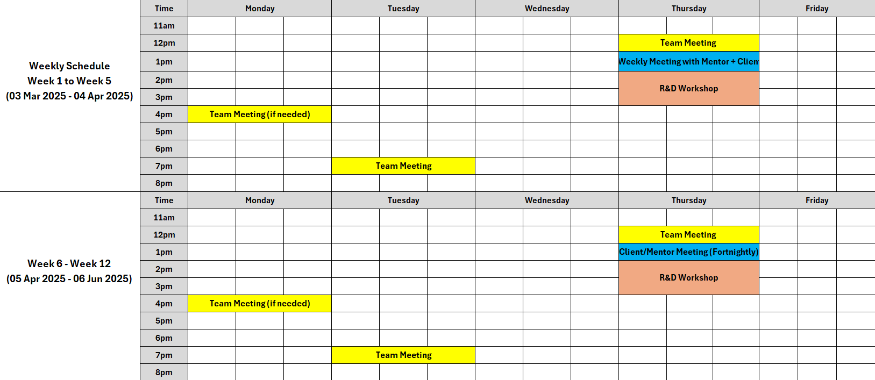
Team Schedule

Slide 15
Work Breakdown Structure (WBS)

Slide 16
Gantt Chart

Slide 17
Conclusion

Slide 18
References

Slide 19
Q&A
We are open to all questions related to the project.

Slide 20

How to create a project proposal
Creating a project proposal can be done in five steps:
Define the project objectives and timeline
Identify resources needed to complete the project
Develop a budget for the project and estimate any potential risks associated with it
Write down your proposed solution and provide supporting documents or evidence that prove its feasibility if necessary
Develop a communication plan to ensure key stakeholders are kept informed of progress throughout the entire process

Slide 21
Project expenses
Labor
Materials
Equipment
Overhead
Other
Follow the link in the graph to modify its data and then paste the new one here. For more info, click here

Slide 22
$500,000
25%
200 units
Net profit of the project
Market share in the industry
Break-even point

Slide 23
Budget
Sources of funding
Personnel costs
Funding for a company can come from personal savings or investments, bank loans and other loan options, venture capital and angel investors, grants, competitions or programs, crowdfunding…
Personnel costs refer to the expenses incurred in hiring, training and retaining staff for a company. This can include salaries, bonuses, benefits and other payroll-related costs
Equipment and materials
Travel and miscellaneous
Equipment and materials costs refer to all the expenses related to the purchasing, maintenance and upkeep of any physical items used in production or other business processes inside the company
Travel and miscellaneous costs refer to expenses related to any travel-related activities, such as conferences, trainings or business trips. It may also include office supplies, communications services, licenses and other miscellaneous expenses

Slide 24
Solutions
Solution 1
Solution 2
Solution 3
Implementing a new CRM (Customer Relationship Management) system to improve customer data management and
sales tracking
Outsourcing specific business functions (such as accounting or IT) to a third-party provider to reduce costs and increase time efficiency
Launching an e-commerce platform to expand the reach of the business and increase online sales
Solution 4
Solution 5
Solution 6
Developing a new product or service to diversify the business and increase revenue streams
Implementing a cost-saving initiative, such as energy-efficient practices or process automation, to reduce expenses
Establishing strategic partnerships with other businesses to gain access to new markets or
innovative technologies

Slide 25
$500,000
25%
200 units
Net profit of the project
Market share in the industry
Break-even point

Slide 26
10 million
First-year revenue of the project

Slide 27
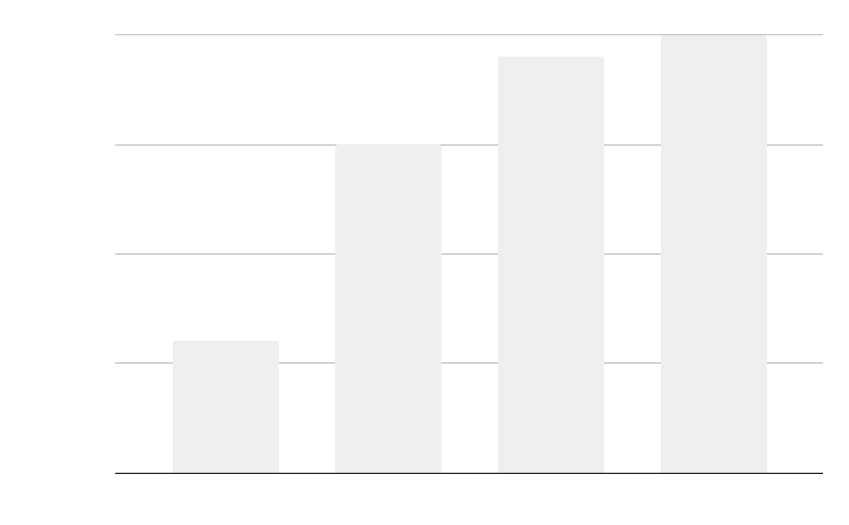
Project data
Benefits of using graphs
Graphs in project proposals offer visual organization, enabling clear presentation of information in a structured format. They enhance the visual appeal, facilitate data comparison and improve overall clarity and professionalism of your project proposal
Follow the link in the graph to modify its data and then paste the new one here. For more info, click here

Slide 28
Project activities
Activity | Start date | End date | Resource | Cost | Revenue
Market research | 1/1/20XX | 1/15/20XX | Market research firm | $20,000 | $200,000
Product development | 1/16/20XX | 6/30/20XX | R&D team | $200,000 | $350,000
Beta testing | 7/1/20XX | 8/15/20XX | Beta testers | $10,000 | $300,000
Marketing campaign | 1/1/20XX | 1/15/20XX | Advertising agency | $100,000 | $400,000
Product launch | 1/16/20XX | 6/30/20XX | Sales team | $50,000 | $500,000
Post-launch support | 7/1/20XX | 8/15/20XX | Support team | $50,000 | $800,000

Slide 29

What to show in a mockup
Product/website description: A brief overview of the product/website, including its key features, dimensions, and materials used
Features and benefits: A detailed explanation of the product's/website's features and how they will benefit the user
Technical specifications: A list of the product's/website's technical specifications, such as dimensions, weight, power requirements, connectivity options and hosting platform

Slide 30
Project timeline
Conduct market research and analyze the target audience to identify opportunities
Create the product or service by defining features, design, and functionality
Test the product with a group of users to receive feedback and improve the product
Execute a marketing campaign to promote the product to the target audience
Release the product or service to the market with a comprehensive launch plan
Provide customer support to ensure customer satisfaction
Explore opportunities for growth and expansion of the product or service
Continuously improve the product based on customer feedback and market trends

Slide 31
Project roadmap
Initiative | Objective | Jan | Feb | Mar | Apr | May | Jun | Jul | Aug | Sep | Oct | Nov | Dec
Market research | Increase brand awareness by 30% within the first year
Product development | Achieve a customer satisfaction rate of 90%
Marketing campaign | Increase revenue by 20% within the first year
Product launch | Achieve a customer satisfaction rate of 90% within the first year
Expansion | Reduce costs by 15% within the first year by expanding the product
Partnership | Reach profitability within 18 months of launch

Slide 32



Photo showcase
A photo showcase can be a useful addition to a business project proposal as it can help to visually communicate the concept or idea being proposed

Slide 33
Project expenses
Labor
Materials
Equipment
Overhead
Other
Follow the link in the graph to modify its data and then paste the new one here. For more info, click here

Slide 34
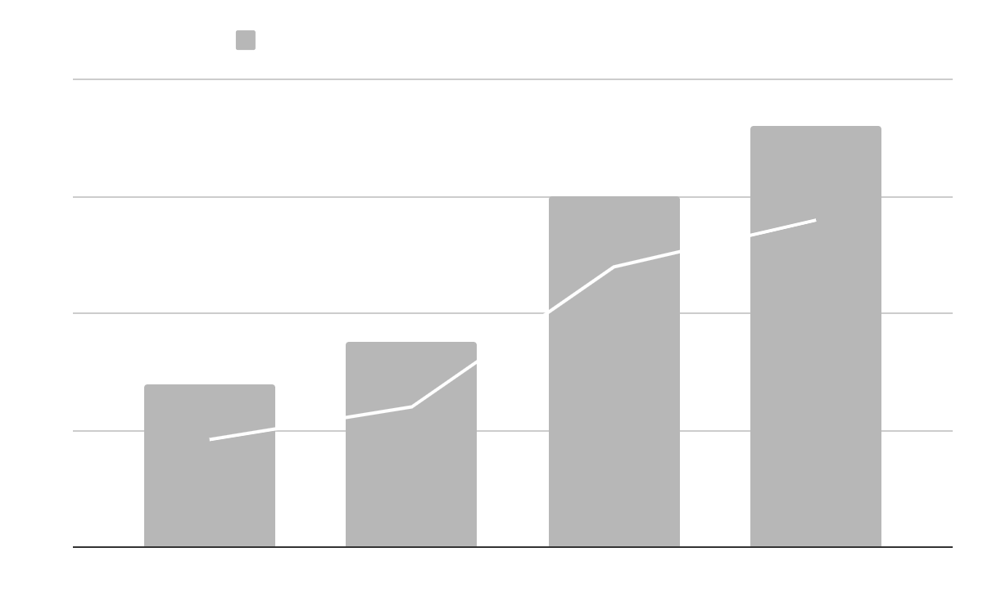
KPI dashboard
120 u/day
2h
Resource | Utilization rate | Cost per unit
Labor | 85% | $50
Equipment | 70% | $100
Materials | 95% | $20
Rent | 90% | $1,000
Energy | 80% | $80
Software licenses | 80% | $200
Advertising | 60% | $500
Output per worker
Time to complete a task
Follow the link in the graph to modify its data and then paste the new one here. For more info, click here

Slide 35
Thanks!
Do you have any questions?
youremail@freepik.com
+34 654 321 432
yourwebsite.com
Please keep this slide for attribution

Slide 36
Alternative resources
Here’s an assortment of alternative resources whose style fits the one of this template:
Vectors
Abstract background with circuits

Slide 37
Resources
Did you like the resources in this template? Get them at these websites:
Vectors
Modern cyber monday composition with flat design
Abstract background with circuits
Photos
Industrial designer working on 3d model
Person using ai tool at job
Close up hand holding smartphone
Facial recognition collage concept
Rpa concept with blurry hand touching screen
Programming background with person working with codes on computer

Slide 38
Instructions for use
If you have a free account, in order to use this template, you must credit Slidesgo by keeping the Thanks slide. Please refer to the next slide to read the instructions for premium users.
As a Free user, you are allowed to:
Modify this template.
Use it for both personal and commercial projects.
You are not allowed to:
Sublicense, sell or rent any of Slidesgo Content (or a modified version of Slidesgo Content).
Distribute Slidesgo Content unless it has been expressly authorized by Slidesgo.
Include Slidesgo Content in an online or offline database or file.
Offer Slidesgo templates (or modified versions of Slidesgo templates) for download.
Acquire the copyright of Slidesgo Content.
For more information about editing slides, please read our FAQs or visit our blog:
https://slidesgo.com/faqs and https://slidesgo.com/slidesgo-school

Slide 39
Instructions for use (premium users)
As a Premium user, you can use this template without attributing Slidesgo or keeping the "Thanks" slide.
You are allowed to:
Modify this template.
Use it for both personal and commercial purposes.
Hide or delete the “Thanks” slide and the mention to Slidesgo in the credits.
Share this template in an editable format with people who are not part of your team.
You are not allowed to:
Sublicense, sell or rent this Slidesgo Template (or a modified version of this Slidesgo Template).
Distribute this Slidesgo Template (or a modified version of this Slidesgo Template) or include it in a database or in any other product or service that offers downloadable images, icons or presentations that may be subject to distribution or resale.
Use any of the elements that are part of this Slidesgo Template in an isolated and separated way from this Template.
Register any of the elements that are part of this template as a trademark or logo, or register it as a work in an intellectual property registry or similar.
For more information about editing slides, please read our FAQs or visit our blog:
https://slidesgo.com/faqs and https://slidesgo.com/slidesgo-school

Slide 40
Fonts & colors used
This presentation has been made using the following fonts:
Aldrich
(https://fonts.google.com/specimen/Aldrich)
Saira
(https://fonts.google.com/specimen/Saira)
#ffffff
#000000
#b7b7b7
#efefef
#cccccc
#666666

Slide 41





Storyset
Create your Story with our illustrated concepts. Choose the style you like the most, edit its colors, pick the background and layers you want to show and bring them to life with the animator panel! It will boost your presentation. Check out how it works.
Pana
Amico
Bro
Rafiki
Cuate

Slide 42
Use our editable graphic resources...
You can easily resize these resources without losing quality. To change the color, just ungroup the resource and click on the object you want to change. Then, click on the paint bucket and select the color you want. Group the resource again when you’re done. You can also look for more infographics on Slidesgo.

Slide 45
JANUARY
FEBRUARY
MARCH
APRIL
MAY
JUNE
PHASE 1
Task 1
Task 2
PHASE 2
Task 1
Task 2
JANUARY
FEBRUARY
MARCH
APRIL
PHASE 1
Task 1
Task 2

Slide 48
...and our sets of editable icons
You can resize these icons without losing quality.
You can change the stroke and fill color; just select the icon and click on the paint bucket/pen.
In Google Slides, you can also use Flaticon’s extension, allowing you to customize and add even more icons.

Slide 49
Educational Icons
Medical Icons

Slide 50
Business Icons
Teamwork Icons

Slide 51
Help & Support Icons
Avatar Icons

Slide 52
Creative Process Icons
Performing Arts Icons

Slide 53
Nature Icons

Slide 54
SEO & Marketing Icons

Slide 55


